Slide 1
ML Model training
Shopee Marketing Analysis

Slide 2
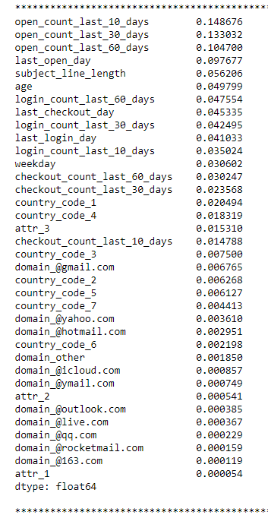
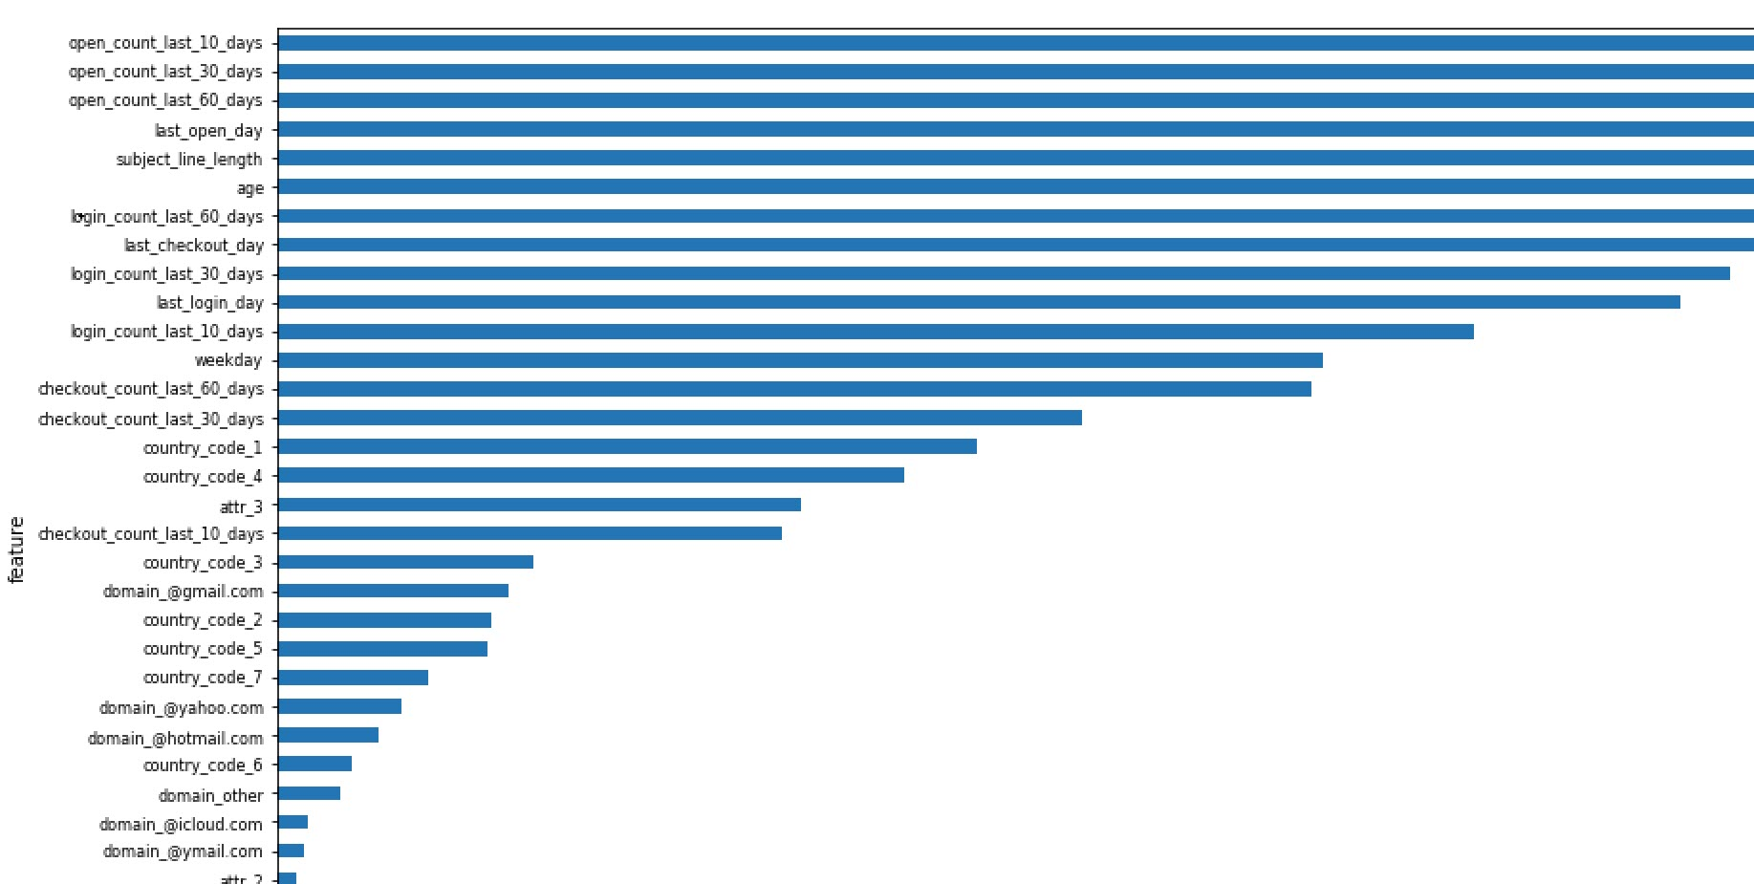
Random Forest Dataset 1

Slide 3
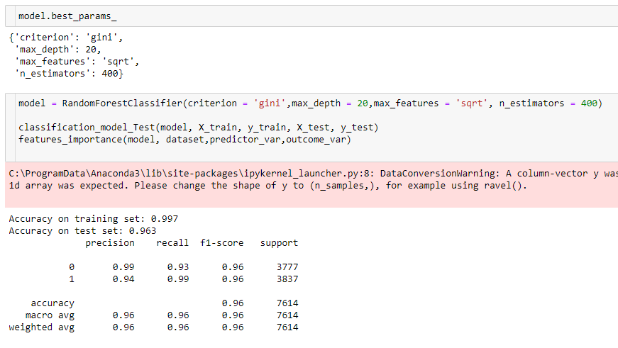

Dataset 1 test set

Slide 4
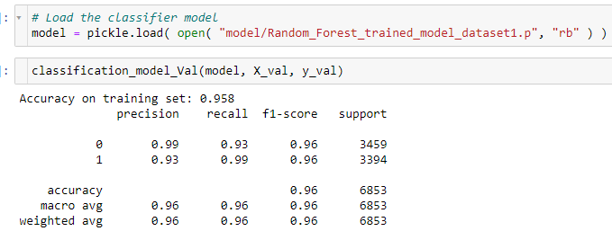

Dataset 1 Val set

Slide 5
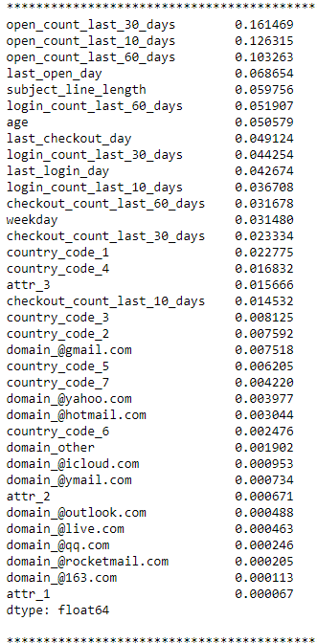
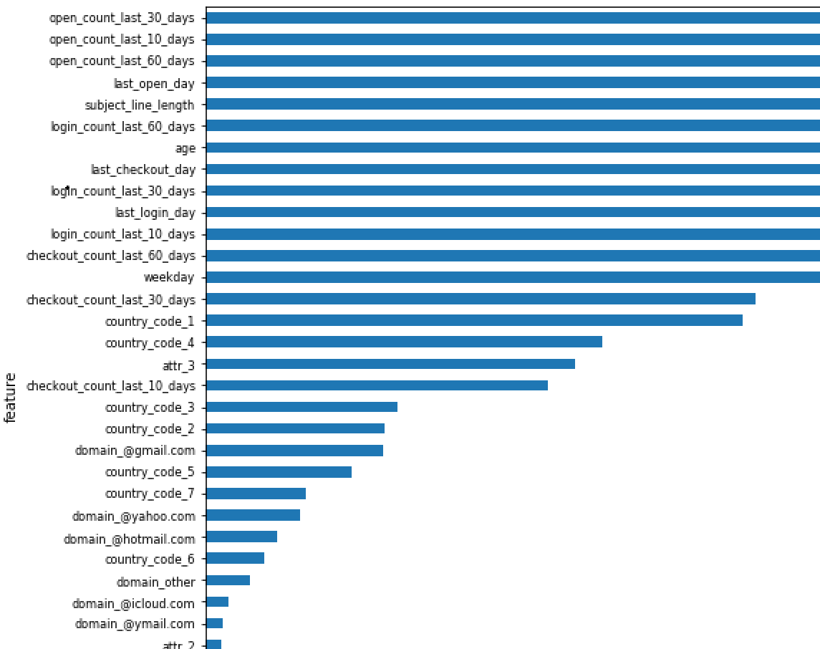
Gradient Boosting Classifier Dataset 1

Slide 6
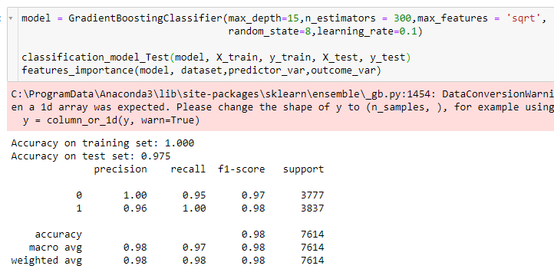

Dataset 1 test set

Slide 7
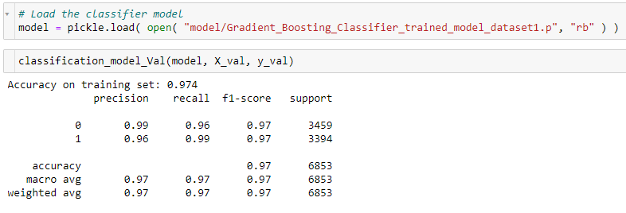

Dataset 1 Val set

Slide 8
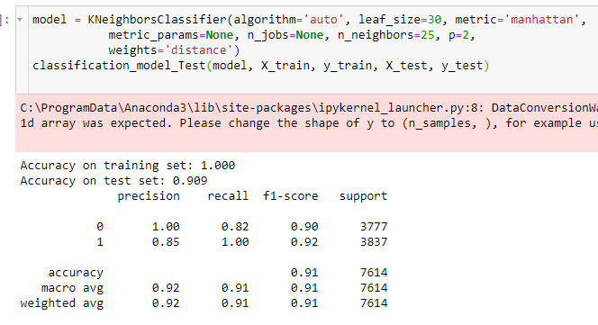

K Nearest Neigbors KNN Dataset 1

Slide 9
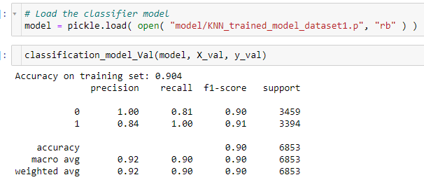

Dataset 1 Val set

Slide 10
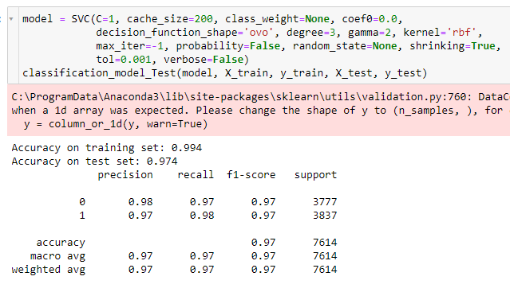
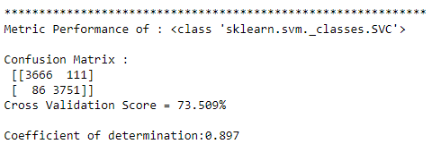
Support Vector Machine SVM Dataset 1

Slide 11
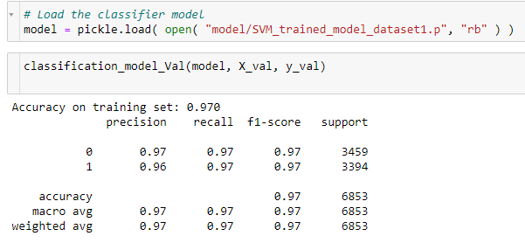
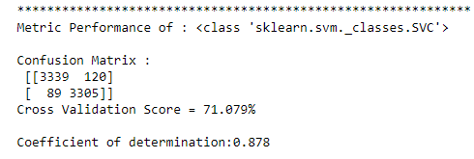
Dataset 1 Val set

